Slide 1
Plastic Tap R8 v. FlexTap
Resonance testing

Slide 2
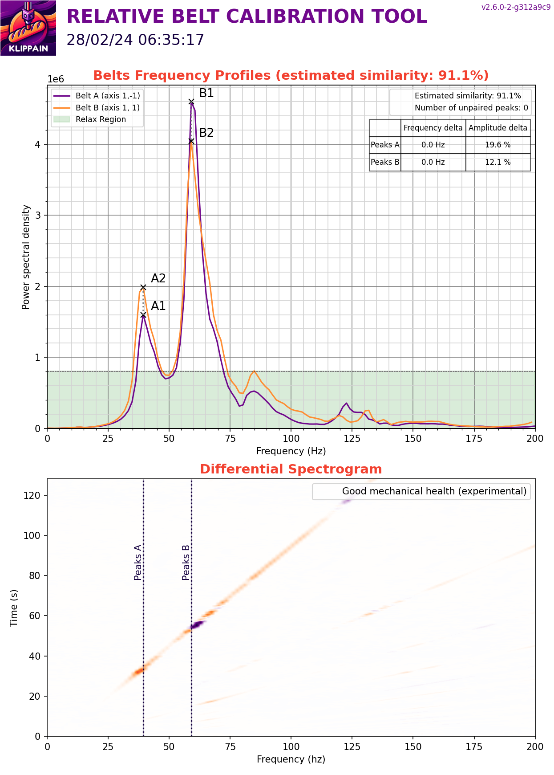
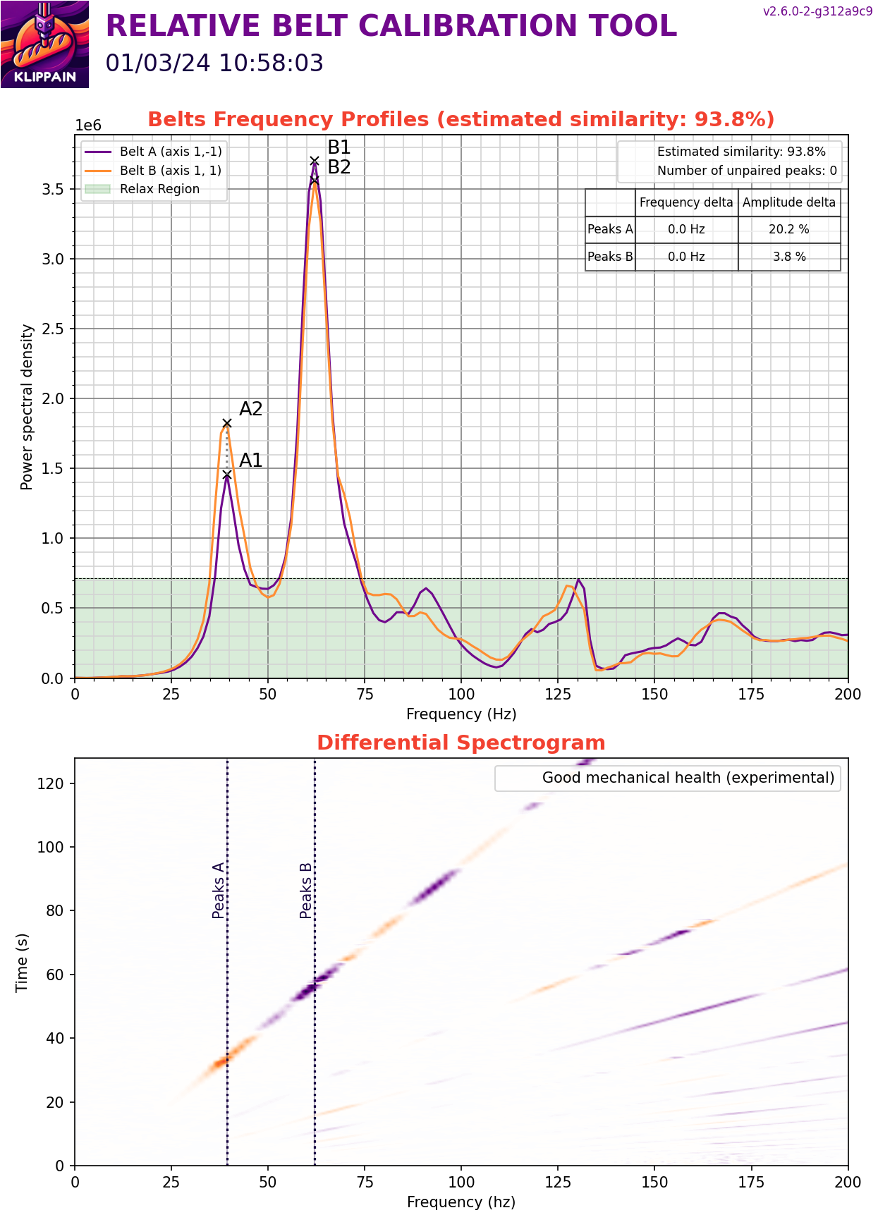
Belt Shaper
Plastic Tap R8
FlexTap

Slide 3
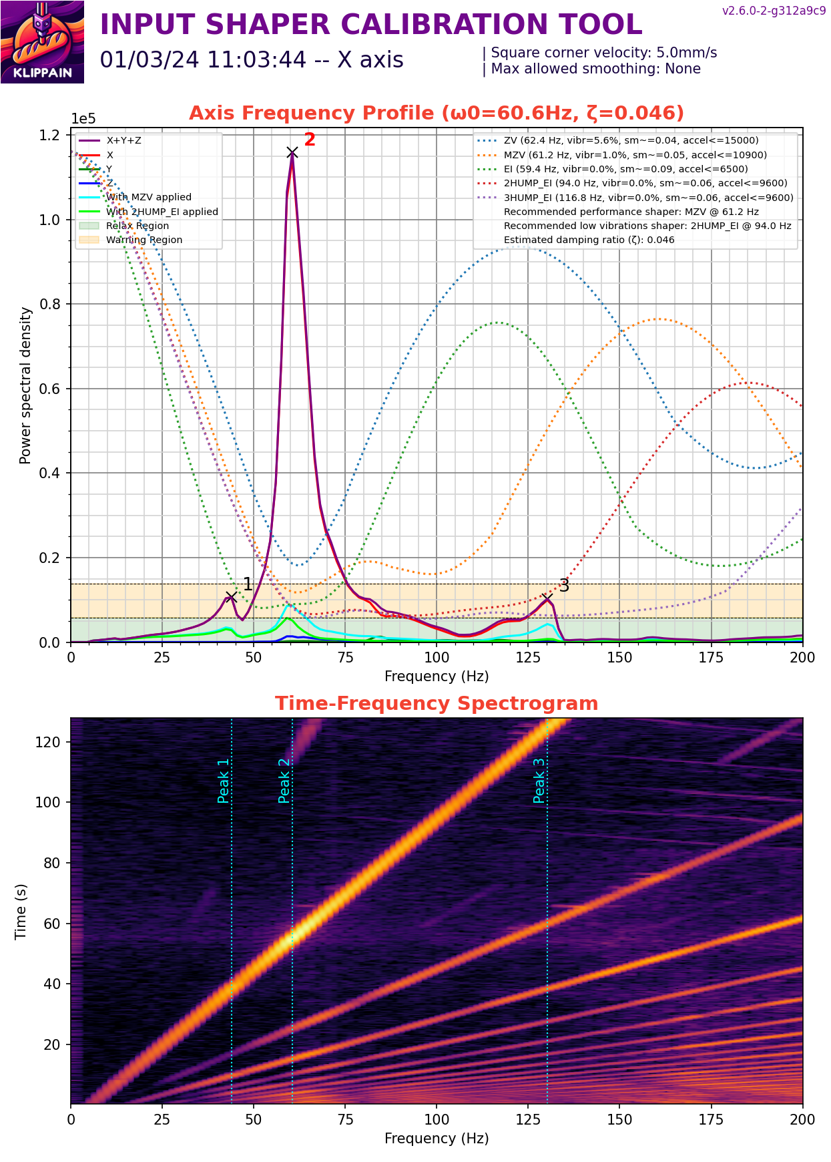
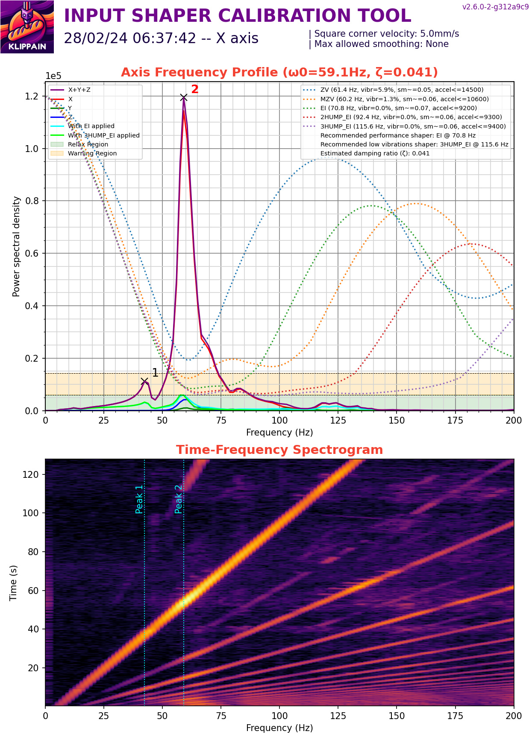
Input shaper X
FlexTap
Plastic Tap R8

Slide 4
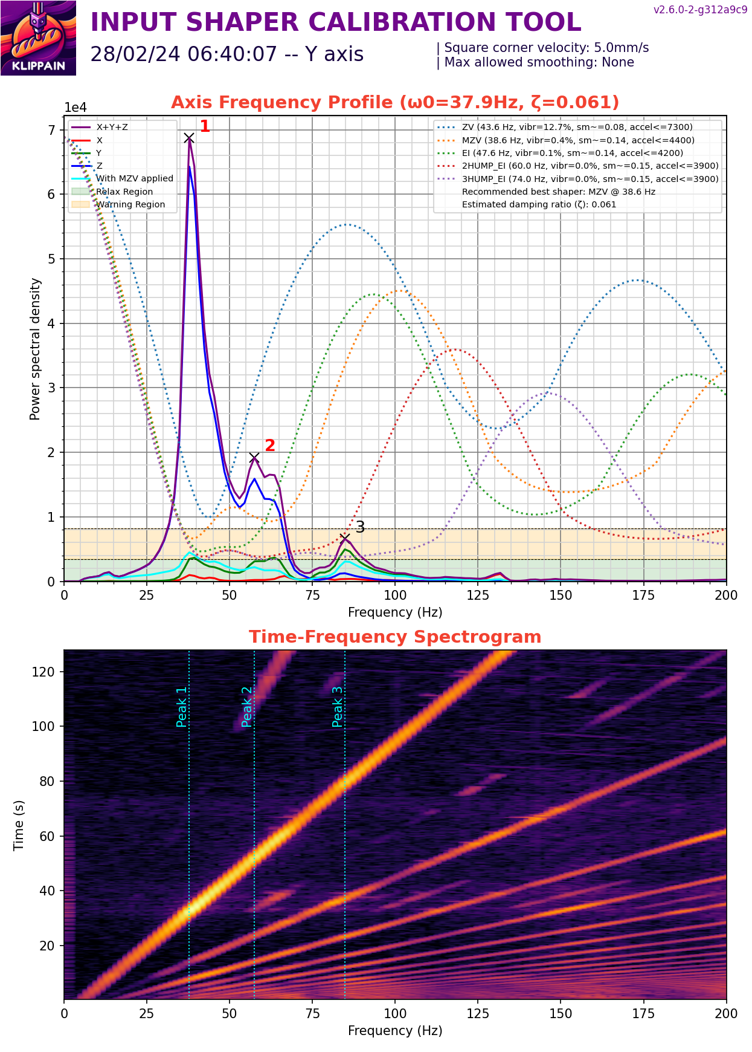
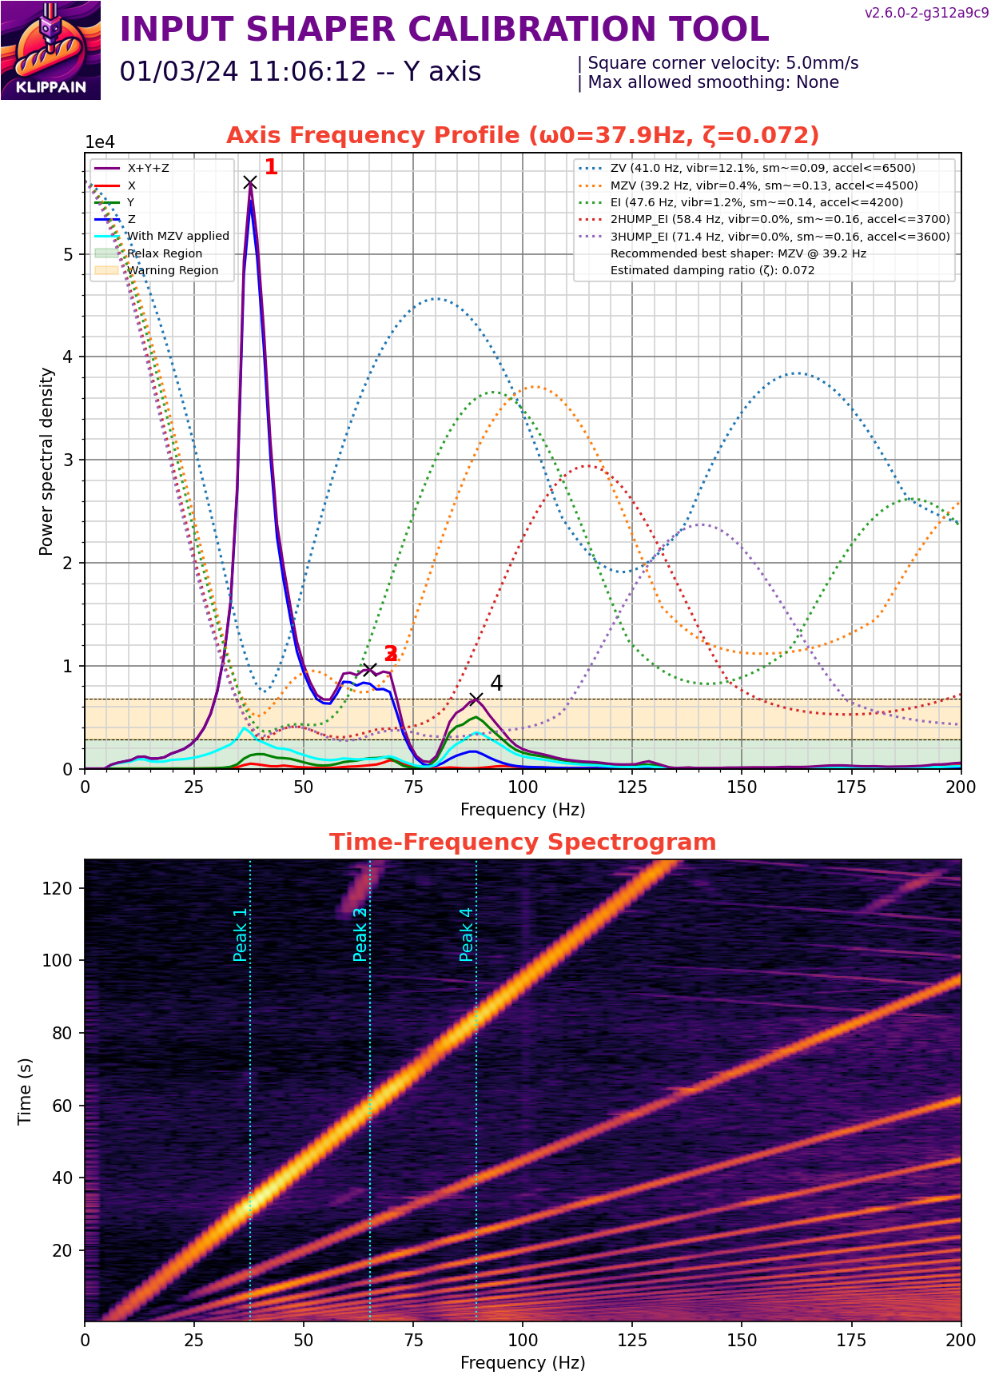
Input shaper Y
Plastic Tap R8
FlexTap

Slide 5
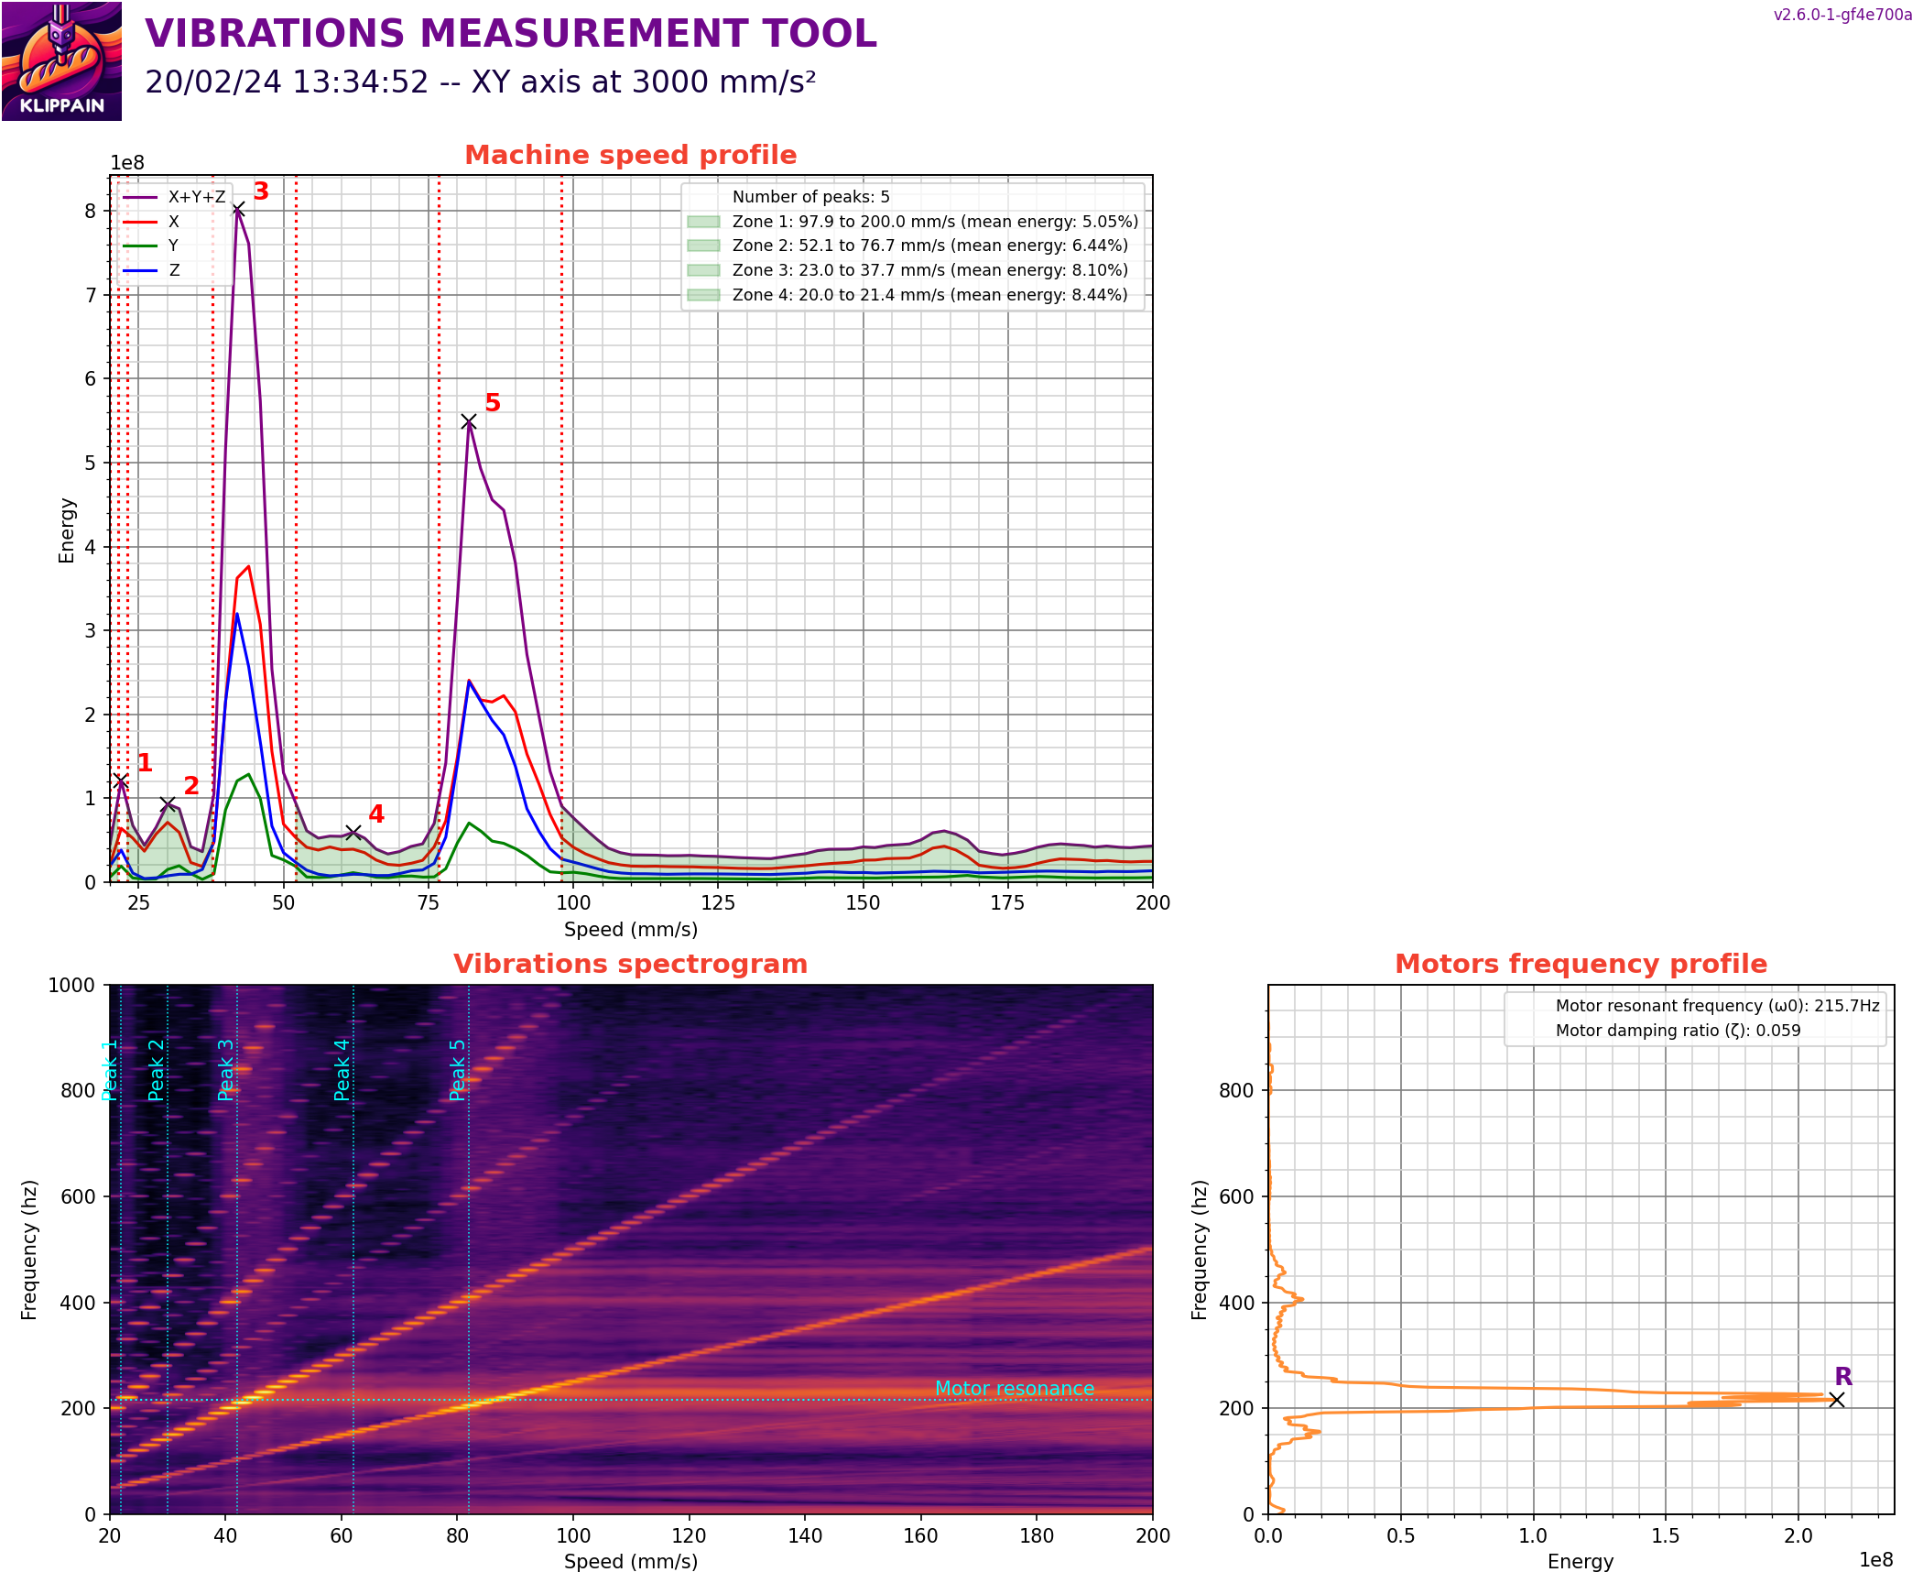
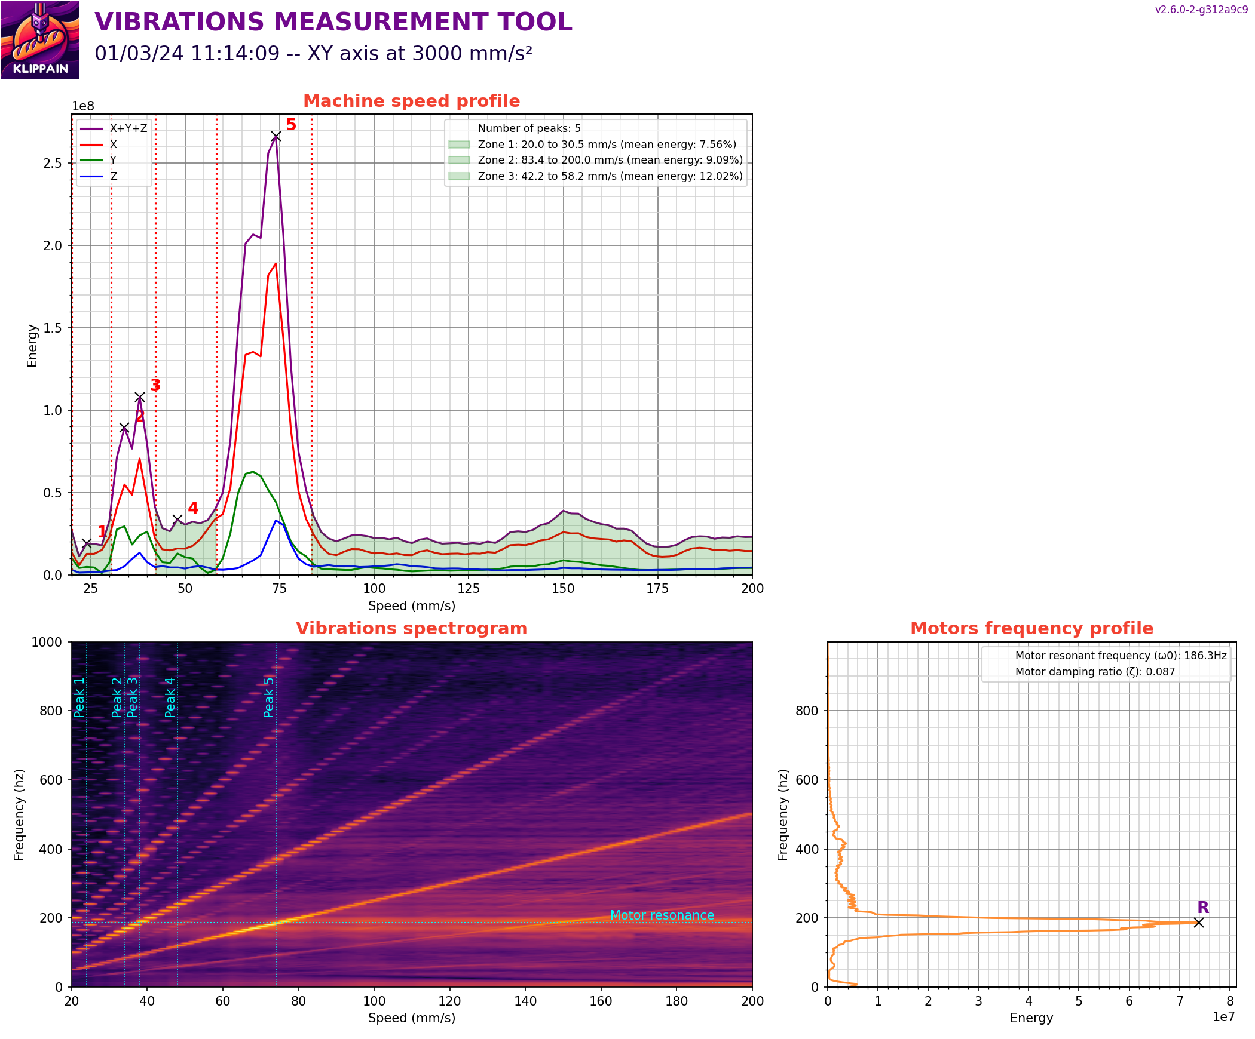
Vibrations Calibration
Plastic Tap R8
FlexTap

Slide 6
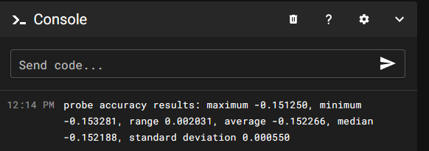
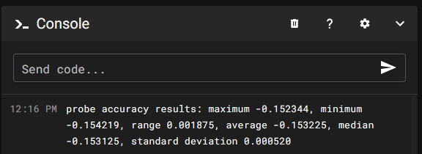
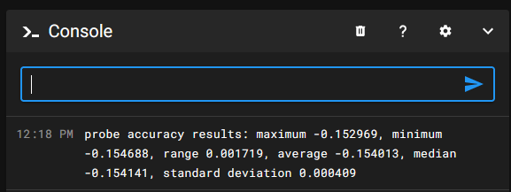



Probe accuracy samples=50
Run #1
Run #2
Run #3

